Slide 1



Hardware and Software Fundamentals of Intelligent Computing Systems

Slide 2
Lecture 42: From Generation to Deployment Integration of Generated Code

Slide 3
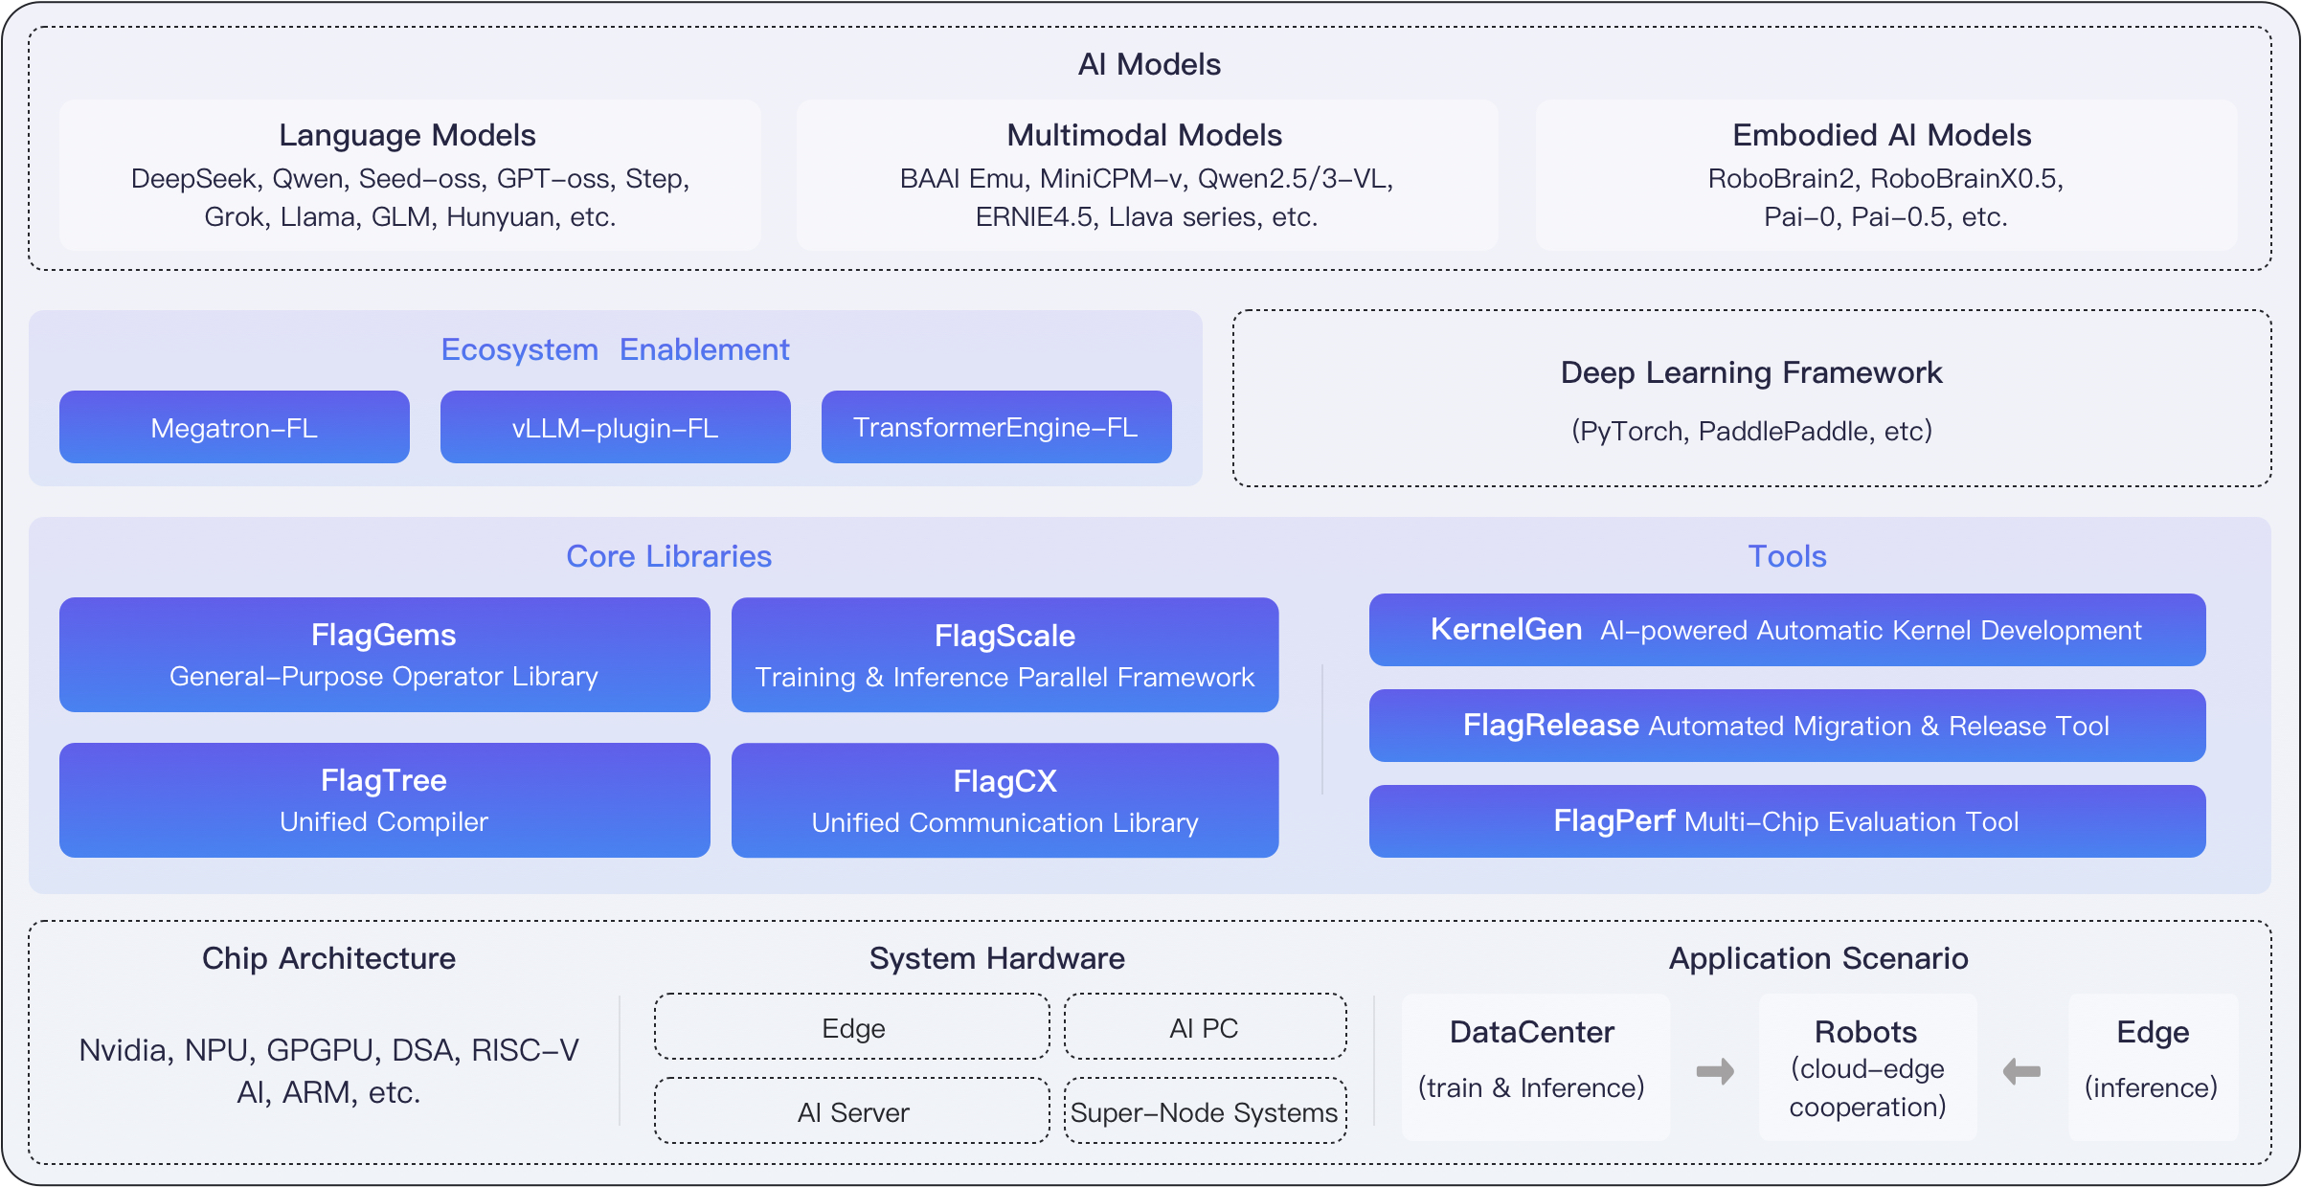
FlagOS Ecosystem Overview
Design Philosophy:“ model- system- chip” decoupling,“ Write Once, Run Anywhere” .
KernelGen (Intelligent Source):LLM -driven operator generation and test verification agent .
FlagGems (High-Performance Operator Library): Based on Triton , a high-performance generalized operator library.
FlagTree (Compilation Engine): A unified MLIR compiler connecting operators with over ten types of heterogeneous chips.
https://docs.flagos.io/en/latest/overview.html

Slide 4
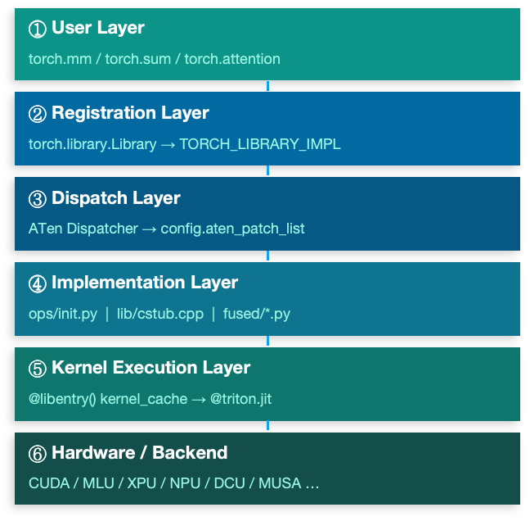
FlagGems Overview
Triton -written, Cross-Hardware Unified:
Natively supports CUDA,MLU,XPU,NPU etc. 10+ hardware backends
High-Performance Operators:
Core training and inference operators including matrix operations, attention mechanisms, normalization, and activation functions
LibEntry Kernel Cache:
In-house dispatch layer replacing Triton native Autotuner, significantly reducing first-compilation overhead and dispatch dispatch latency
Dual-Mode Deployment:
Pure Python package (quick validation) and C++ extension (production acceleration) freely switchable;C++ path eliminates Python call frame overhead
Configuration-Driven Tuning:
LibTuner automatically searches for optimal hyperparameters and persists them as YAML; cold start directly reuses them without re-running benchmark

Slide 5
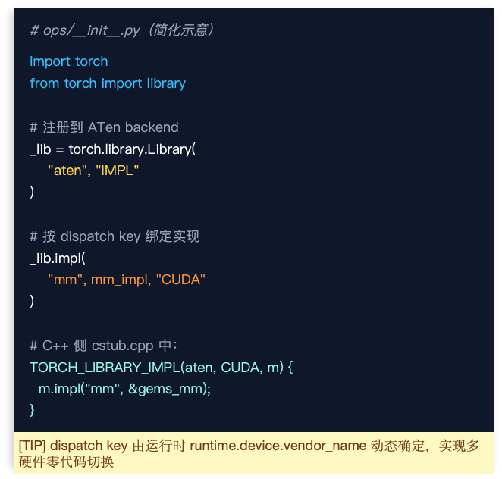
FlagGems Operator Registration and Dispatch
User calls
flag_gems.enable() or flag_gems.use_gems()
Triggers module initialization, traversing ops/init.py
Library Registration
torch.library.Library("aten", "IMPL")
registers implementations by dispatch key(CUDA/XPU…
TORCH_LIBRARY_IMPL
C++ side: aten::mm → mm,aten::add.Tensor → add, overridesATen operator table default implementations in.
ATen Dispatcher Routing
config.aten_patch_list decision

Slide 6
FlagGems Operator Compilation
Triton source code (.py)
Operators are written in Triton DSL (ops/mm.py,ops/attention.py , etc.)
decorator @triton.jit marks JIT JIT compilation entry point
@libentry() decorator — replaces Autotuner
LibEntry independently manages kernel_cache, bypassing Triton native Autotuner runtime
First call triggers JIT compilation;LibEntry independently manages cache to avoid Autotuner overhead
@triton.jit → Triton Compiler → PTX / ISA (varies by backend)
Compiled artifacts cached in kernel_cache; subsequent calls directly hit the cache
LibTuner — Hyperparameter Search
BenchmarkCache records BLOCK_M/N/K,num_warps,stages and other optimal configurations
★ 1st call → Triton JIT compilation (slow) | Subsequent calls → kernel_cache direct hit (fast) | Cold start optimization: Preload ConfigCache

Slide 7
FlagGems Runtime Loading
[PY] Pure Python Mode (Pure Package)
pip install flaggems (no C++ compilation)
ops/__init__.py Verify via torch.library registration
dispatch path:Python function call stack
Suitable for quick validation / CI testing environments
Overhead:Python call frame + GIL contention
[C++] C++ Extension Mode (with C++ Runtime)
pip install flaggems[cpp] (compiles cstub.cpp)
lib/cstub.cpp → TORCH_LIBRARY_IMPL macro registration
dispatch path:C++ function pointers, zero Python overhead
Suitable for production deployment / inference acceleration scenarios
Significantly reduces short-operator dispatch dispatch latency
VS

Slide 8
FlagTree System Overview
Unified Multi-Chip AI Operator Compiler · Based on Triton & MLIR Ecosystem
Supported Chip Backends (10+ domestic and international mainstream AI chips)
NVIDIA,Cambricon,Tsingmicro,Huawei Ascend,Moore Threads, etc.
Multiple Triton version branches (v3.1 ~ v3.5) maintained in parallel; independent CI/CD
Python Frontend
Compiler Middle Layer
Backend Code Generation
Runtime Loading
@triton.jit
FlagGems LibEntry
MLIR Dialects
Triton-IR / TTGIR
LLVM-IR → PTX
ASM / Vendor Toolchain
JIT Cache
Unified HW Manager
▶
▶
▶

Slide 9
FlagTree Operator Compilation Pipeline ①
Frontend Parsing · Triton-IR · TritonGPU-IR Optimization
Python kernel + AST parsing
@triton.jit decorator triggers JIT; the frontend traverses the Python AST AST, identifies tile-level tensor operations, and builds Triton-IR. tile Triton-IR.
Triton-IR → TritonGPU-IR
The optimization module injects Layout Encoding,, generates TritonGPU IR, and executes common passes: pass:CSE,DCE inline, etc..
TritonGPU-IR → LLVM-IR
Vendor-specific pass passes further optimize TTGIR; finally, through the MLIR → LLVM bridge layer, outputs LLVM-IR, completing the high-level optimization phase.

Slide 10
FlagTree Operator Compilation Pipeline ②
LLVM-IR → Assembly → binary · Pluggable Backend · Compilation Cache
Backend pluggable architecture (third_party/)
Compilation result caching mechanism
Phase | Input | Output | Toolchain
LLVM Optimization | LLVM-IR | Optimized LLVM-IR | LLVM opt passes
Assembly Generation | LLVM-IR | PTX / AMDGCN / Vendor ASM | LLVM backend + Vendor Driver
Device Compilation | ASM / BC | .cubin / .hsaco / binary | NVCC / HIPCC / Vendor Compiler
Cache Write | Compiled artifacts | kernel_hash.bin | ~/.triton/cache/

Slide 11
FlagTree Runtime Loading and Unified Hardware Abstraction Layer
FlagTree Hints —— Runtime Behavior Extension
flagtree_hints (shared_mem)
flagtree_hints (async_dma)
FLIR Middle Layer
①
②
③
④
First call triggers JIT
Compilation or cache hit
Dynamic library loading
Kernel dispatch and execution
The kernel wrapped by @triton.jit is called for the first time; a specialization key based on actual dtype/shape is used to query the disk cache.
▶
On cache miss, the full compilation pipeline starts and results are written to disk; on cache hit, the pre-compiled binary is read directly.
▶
Via cuModuleLoadData (NVIDIA) / hipModuleLoad (AMD) or vendor-equivalent API to load onto the device and obtain the kernel handle.
▶
UnifiedHardware Manager provides unified launch API wrapping, shielding vendor differences; FlagTree replaces the system triton package for seamless upper-layer framework switching.

Slide 12
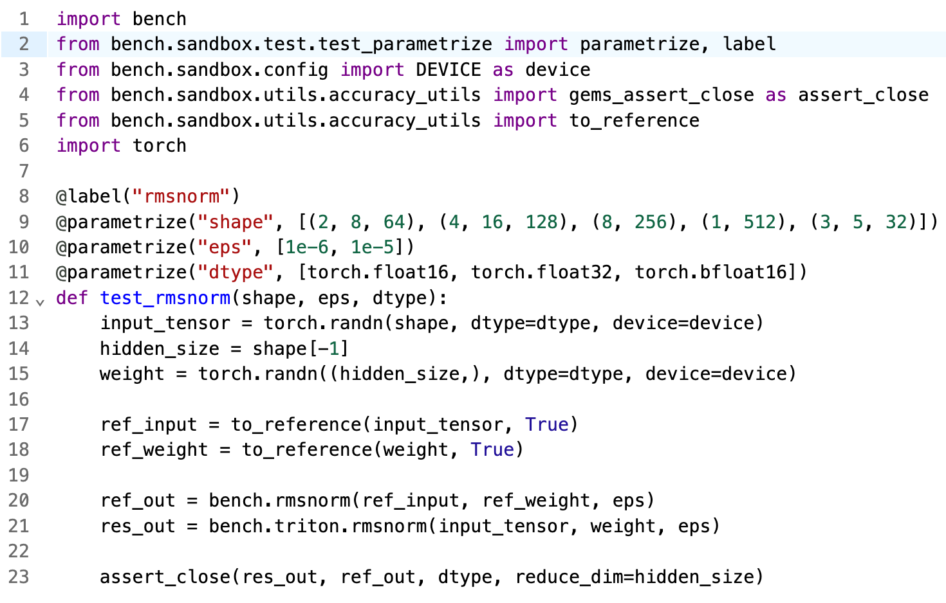
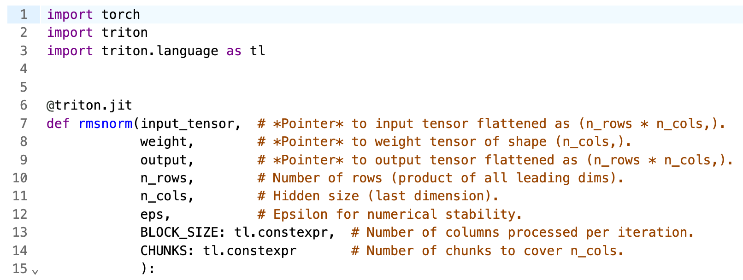
KernelGen Generated Code Examples
KernelGen The code generated by KernelGen is functionally complete
In terms of engineering structure, it typically manifests as a hybrid single file containing business logic, test utilities, and plotting scripts

Slide 13
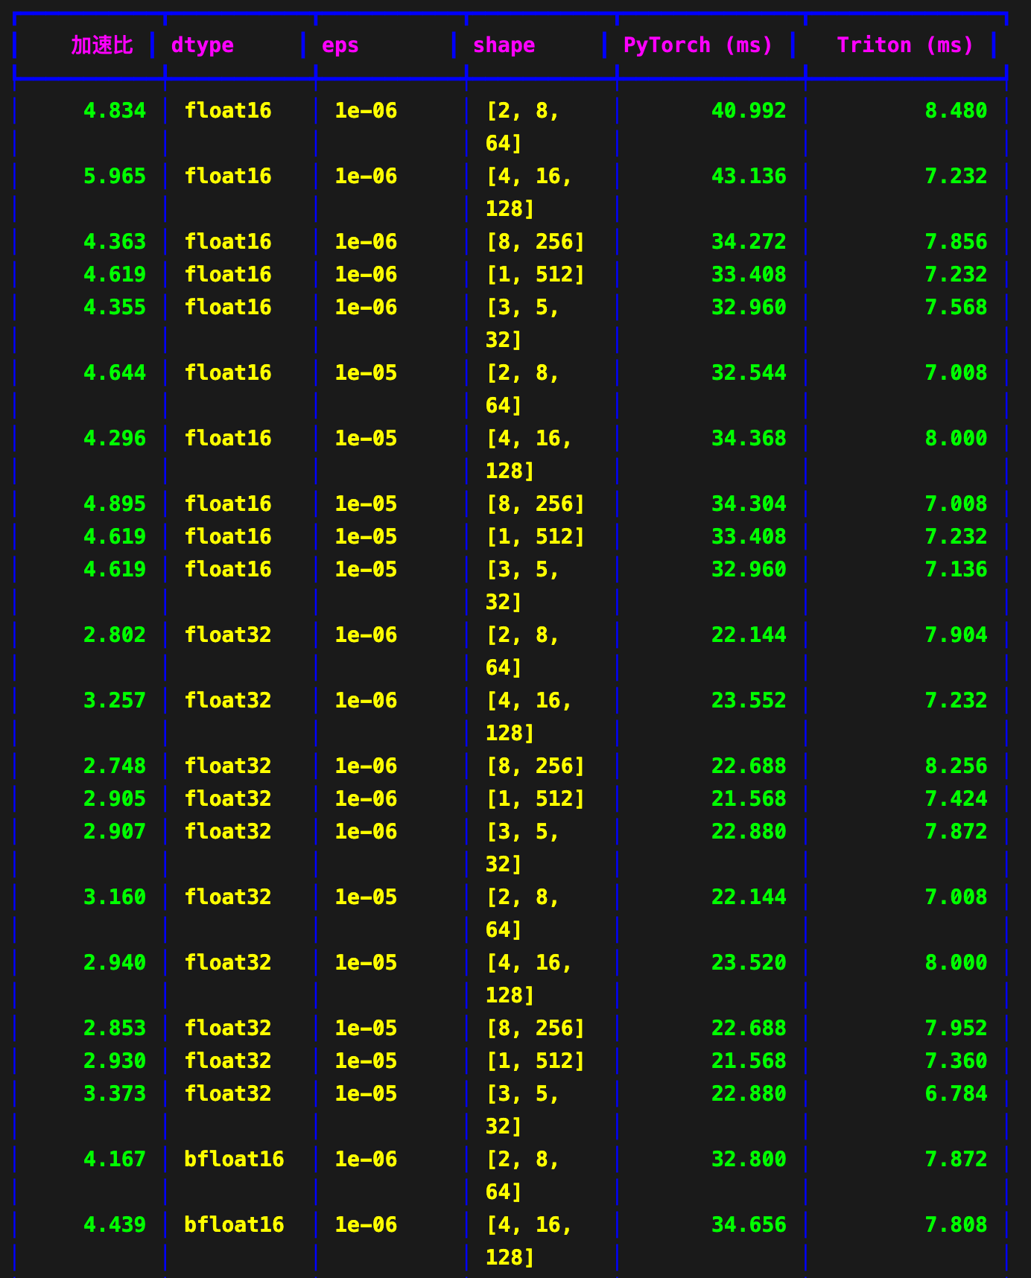
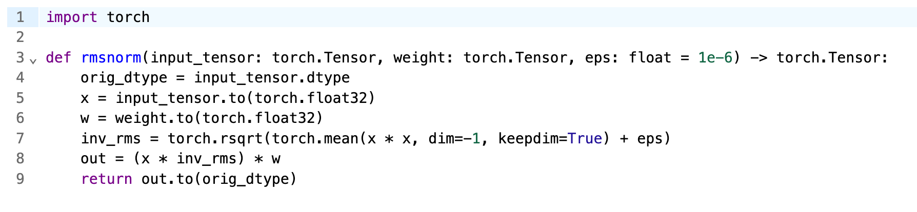
Engineering Criteria for Operator Integration
KernelGen 's generated operators must satisfy:
Pass correctness verification in an isolated environment
andCUDA baseline implementation comparison
The baseline implementation is also generated byKernelGen
Meet preset benchmarks in performance testing

Slide 14
Standardized Refactoring
Execution Logic:AST parsing and structural cleanup, transforming the original code into standardized operator library modules .
Kernel Extraction: Strip benchmarking code, dynamize grid configuration.
Dependency Injection: Mount FlagGems 's dedicated @libentry decorator to integrate with the cache dispatch mechanism .
Test Migration: Refactor assertions into the standard pytest parameterized test framework.
https://github.com/flagos-ai/KernelGen/tree/main/tools

Slide 15
Standardized Refactoring
KernelGen Original File Output | convert.py Parsing Behavior and Structural Cleanup | FlagGems Target Module Mapping
[operator]_triton.py | Strip all performance benchmarks and test stub code. Extract the main kernel function containing @triton.jit. Convert KernelGen-generated hardcoded launch parameters to dynamic grid configurations; inject FlagGems' dedicated @libentry decorator for mounting auto-tuning and heuristic rule caching mechanisms. | src/flag_gems/ops/[operator].py
[operator]_baseline.py | Extract the native PyTorch or CUDA operator implementation as the baseline reference, wrapping it as the benchmark function in the test suite. | Extracted for test module invocation.
test_[op]_accuracy.py | Refactor assertion logic. Transform standalone assertion scripts into standard pytest framework unit test classes. Inject parameterized decorators for different data types (FP16, BF16, FP32) parameterized decorators, and add boundary tests for NaN,Inf and other atypical values with boundary condition handling. | tests/[operator]_test.py
test_[op]_performance.py | Clean up chart generation code. Retain key Throughput (Throughput) and Latency (Latency) evaluation logic, and integrate into FlagGems 's automated CI/CD performance benchmark (Benchmark) evaluation pipeline to ensure regression test stability. | tests/[operator]_test.py
https://github.com/flagos-ai/KernelGen/tree/main/tools

Slide 16
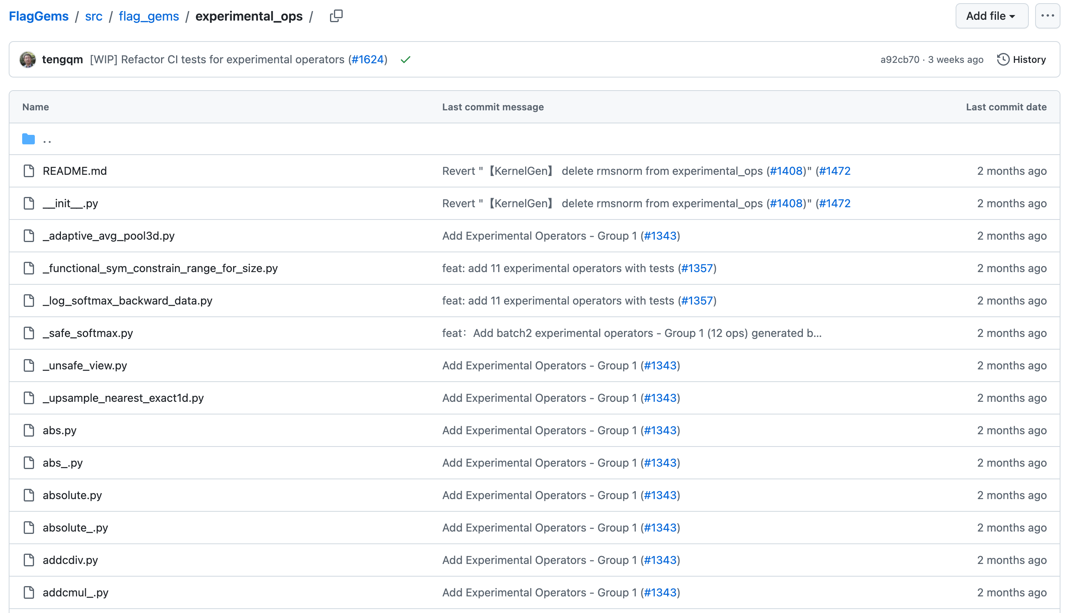
SubmitPR toexperimental_ops
https://github.com/flagos-ai/FlagGems/tree/master/src/flag_gems/experimental_ops

Slide 17

The Solution: FlagOS, a Unified AI Software Stack

Slide 18








https://space.bilibili.com/3546791834290849
https://github.com/flagos-ai
https://www.zhihu.com/people/95-22-20-18/posts
https://flagos.io/Home

Slide 19

Thanks for your time！

